Slide 1





Slide 2


01
The Challenge
Business requirements to this task
02
Methodology
Thinking and planning before any action
03
Development
All steps to achieve the goal
04
Conclusion
Sharing some ideas of improvement

Slide 3


1
Search for tweets mentioning #FlixBus (last week)
2
Store the raw data
3
From the raw data extract some attributes
4
Apply anonymization on User id
5
Prevent some pipeline issues
6
Feature of reprocessing (day, range)

Slide 4
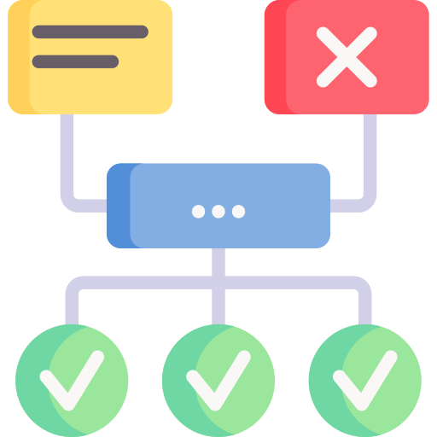
Methodology
Gathering requirements
Tech Stack definition
POC
Development
Documentation

Slide 5





Development

Slide 6
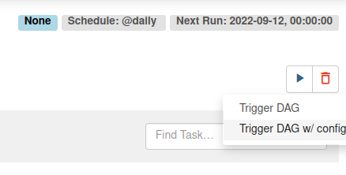
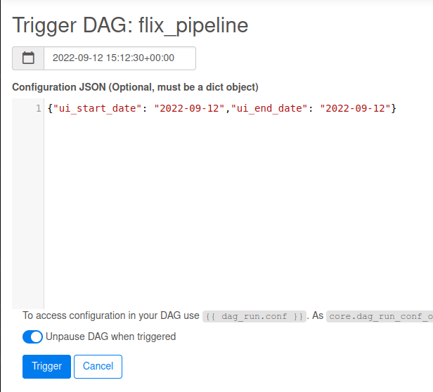
Development
Reprocessing using single date or range
From UI click on arrow signal and choose the option with config.
Fill the text box with both dates to ask data from a range or set only the ui_start_date attribute that it will be considered as a single day

Slide 7
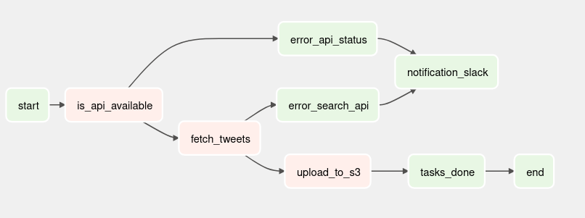
Development
Pipeline
In case of error to check the API status or not found any tweet the task is going to fail and a notification should be send to Slack. NOTE: Communication with SLACK is not implemented, it was added only as example to handle issues.
1
Check if API is available
2
Fetch tweets from API
3
Upload data to S3

Slide 8
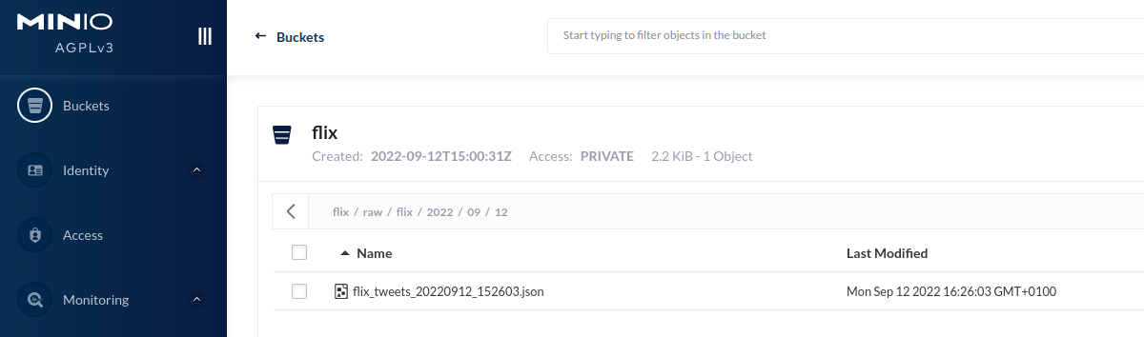
Development
Data stored with attributes
After retrieve the data and extract what is required (also anonymization) the data has been write out to MinIO (S3) and is available on URL below http://localhost:9001

Slide 9

Conclusion
All requirements were achieved but also at the end some possibilities of improvement were detected.
Store data in a different format as Parquet
Implement notification to Slack or other tool.
Improve context of reprocessing to be dynamic
Start to develop it to Tweeter V2 API version

Slide 10
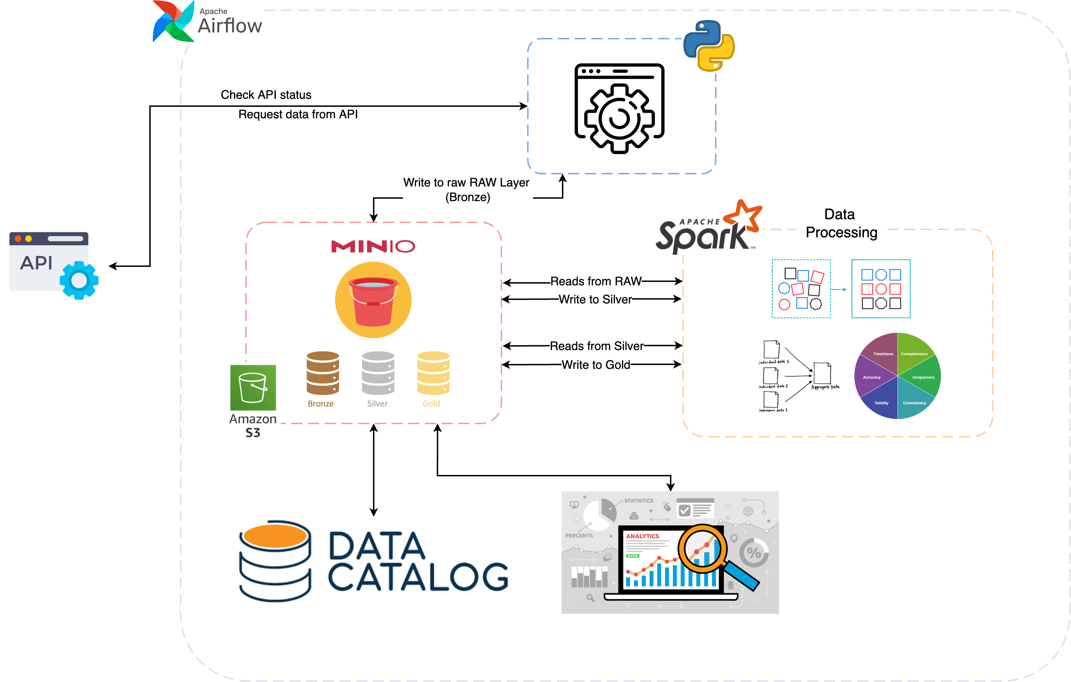
Architecture

Slide 11





